Slide 1
Maximal Unitarity at Two Loops
David A. Kosower Institut de Physique Théorique, CEA–Saclay
work with Kasper Larsen; & with Krzysztof Kajda & Janusz Gluza 1009.0472 & 1108.1180
Amplitudes 2011 University of Michigan, Ann Arbor November 12, 2011

Slide 2
Amplitudes in Gauge Theories
Explicit calculations in N=4 SUSY have lead to a lot of progress in discovering new symmetries (dual conformal symmetry) and new structures not manifest in the Lagrangian or on general grounds
Basic building block for physics predictions in QCD
NLO calculations give the first quantitative predictions for LHC physics, and are essential to controlling backgrounds: require one-loop amplitudes
For some processes (gg → W⁺W⁻, gg → ZZ) two-loop amplitudes are needed
For NNLO & precision physics, we also need to go beyond one loop

Slide 3
On-Shell Methods
Use only information from physical states
Use properties of amplitudes as calculational tools
Factorization → on-shell recursion (Britto, Cachazo, Feng, Witten,…)
Unitarity → unitarity method (Bern, Dixon, Dunbar, DAK,…)
Underlying field theory → integral basis
Formalism
Known integral basis:
On-shell Recursion; D-dimensional unitarity via ∫ mass
Unitarity

Slide 4
Knowledge of Integrals
Master Integrals for Feynman-diagram based calculations
Not essential in principle
Don’t have to be algebraically independent
Required only to streamline calculations
Process-dependent basis integrals
Needed for ‘minimal generalized unitarity’ calculations (just enough cuts to break apart process into trees)
Can be deduced as part of the unitarity calculation, on a process-by-process basis
All-multiplicity results & Numerical applications of unitarity
Require a priori knowledge of algebraically independent integral basis

Slide 5
Higher Loops
Two kinds of integral bases
To all orders in ε (“D-dimensional basis”)
Ignoring terms of O(ε) (“Regulated four-dimensional basis”)
Loop momenta D-dimensional
External momenta, polarization vectors, and spinors are strictly four-dimensional
Basis is finite
Abstract proof by A. Smirnov and Petuchov (2010)

Slide 6
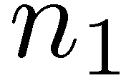
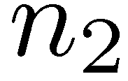
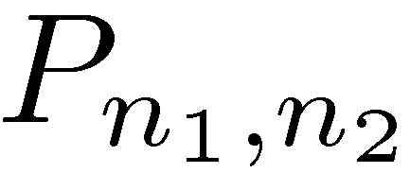
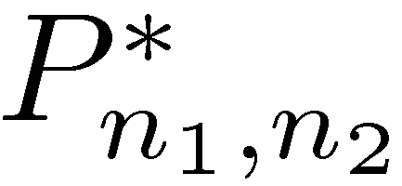
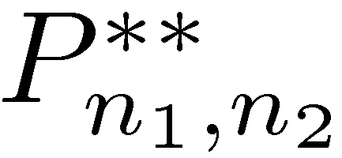
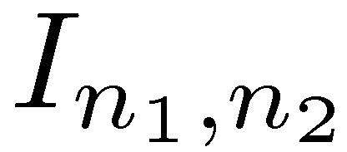
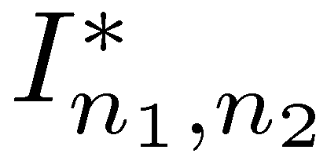
Planar Two-Loop Integrals
Massless internal lines; massless or massive external lines

Slide 7
Tools & Methods
Tensor reduction ⇒ D-dimensional basis
Brown and Feynman (1952); Passarino and Veltman (1979)
Integration by parts (IBP) ⇒ D-dimensional basis
Tkachov and Chetyrkin (1981); Laporta (2001); Anastasiou and Lazopoulos (2004); A. Smirnov (2008)
Gram determinants
vanish when p_{i} or q_{i} are linearly dependent
⇒ D- & four-dimensional basis

Slide 8
Planar Two-Loop Integrals
Part A: Reduce to a finite basis
Step 1. Tensor reduction: consider P_{n1,n2}[ℓ₁∙ v₁ ℓ₁∙ v₂… ℓ₁∙ v_{n}] (n₁≥4); re-express v₁ in terms of first four momenta (on ℓ₁ loop); reduce as at one loop
Step 2. Reduce scalar integrals with (n₁>4) as at one loop,
using
Basis contains integrals
with scalar numerators, reducible or irreducible numerators — new feature at two loops, (example: ℓ₁∙ k₄ in double box)
⇒ Explicit finite basis

Slide 9
Part B: Reduce to independent basis
Step 3. Tensor reductions: remove reducible numerators as at one loop
Step 4. Use integration by parts to arrive at a set of master integrals: generically, (ℓ₁∙ k₄)² is reducible by IBP even when ℓ₁∙ k₄ isn’t
This is the D-dimensional basis
As at one loop, Gram determinant identities give additional equations to O (ε), and thence the regulated four-dimensional basis

Slide 10
Honing Our Tools
Standard IBP ⇒ lots of unwanted integrals, huge systems of equations
Doubled propagators
Can we avoid them?
First idea: choose v such that
But this is too constraining
Sufficient to require for all propagators simultaneously
(σ = 0,1; u_{j} arbitrary polynomial in the symbols with ratios of external invariants treated as parameters)

Slide 11
Solving for IBP-Generating Vectors
Write a general form for the vectors v_{1,2}
c_{i} are f(independent invariants)
Organize equations
Use Grobner bases to solve these Buchberger (1965)
“textbook” material, for appropriate choice of textbook
rows correspond to coeffs
columns correspond to propagators

Slide 12
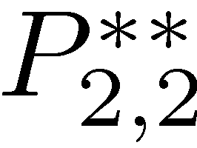
Double box example

Slide 13
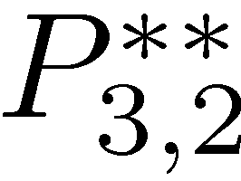
Examples
Massless, one-mass, diagonal two-mass, long-side two-mass double boxes : two integrals
Short-side two-mass, three-mass double boxes: three integrals
Four-mass double box: four integrals
Massless pentabox : three integrals
All integrals with n₂ ≤ n₁ ≤ 4, that is with up to 11 propagators
⇒ This is the D-dimensional basis

Slide 14
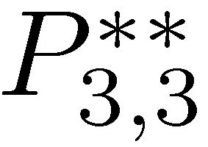
O (ε) Gram dets give no new equations for double boxes
Reduce three integrals for the pentabox to one
Reduce all double pentagons to simpler integrals
Eliminate all integrals beyond the pentabox , that is all integrals with more than eight propagators
⇒ Regulated four-dimensional basis, dropping terms which are ultimately of O(ε) in amplitudes

Slide 15
Unitarity-Based Calculations
Bern, Dixon, Dunbar, & DAK, ph/9403226, ph/9409265
Replace two propagators by on-shell delta functions
⇒ Sum of integrals with coefficients; separate them by algebra

Slide 16
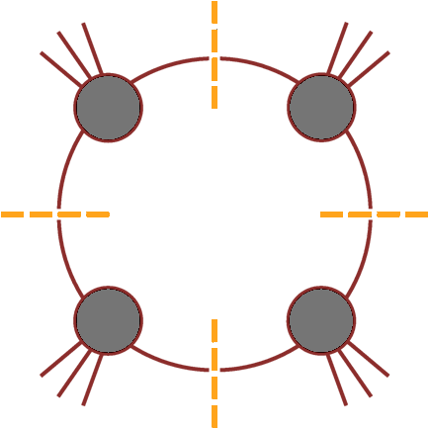
Isolate a single integral
D = 4 → loop momentum has four components
Cut four specified propagators (quadruple cut) would isolate a single box
Britto, Cachazo & Feng (2004)

Slide 17
Quadruple Cuts
Work in D=4 for the algebra
Four degrees of freedom & four delta functions
… but are there any solutions?

Slide 18
A Subtlety
The delta functions instruct us to solve
1 quadratic, 3 linear equations ⇒ 2 solutions
If k₁ and k₄ are massless, we can write down the solutions explicitly
solves eqs 1,2,4;
Impose 3rd to find
or

Slide 19
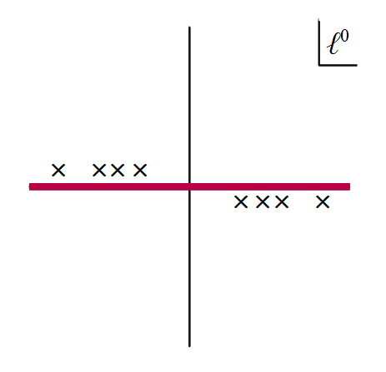
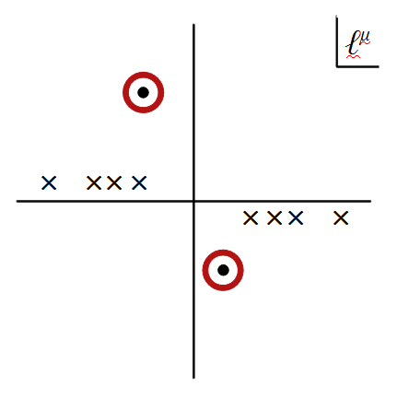
Solutions are complex
The delta functions would actually give zero!
Need to reinterpret delta functions as contour integrals around a global pole
Reinterpret cutting as contour deformation

Slide 20
Two Problems
We don’t know how to choose the contour
Deforming the contour can break equations:
is no longer true if we deform the real contour to circle one of the poles
Remarkably, these two problems cancel each other out

Slide 21
Require vanishing Feynman integrals to continue vanishing on cuts
General contour
⇒ a₁ = a₂

Slide 22
Box Coefficient
A
B
D
C
Go back to master equation
Deform to quadruple-cut contour C on both sides
Solve:
No algebraic reductions needed: suitable for pure numerics
Britto, Cachazo & Feng (2004)

Slide 23
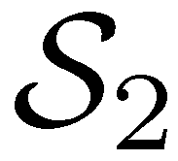
Massless Planar Double Box
[Generalization of OPP: Ossola & Mastrolia (2011)]
Here, generalize work of Britto, Cachazo & Feng, and Forde
Take a heptacut — freeze seven of eight degrees of freedom
One remaining integration variable z
Six solutions, for example

Slide 24
Need to choose contour for z within each solution
Jacobian from other degrees of freedom has poles in z: overall, 14 solutions aka global poles
Note that the Jacobian from contour integration is 1/J, not 1/|J|

Slide 25
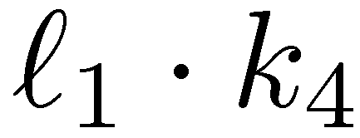
Two basis or ‘master’ integrals: I₄[1] and I₄[ℓ₁∙k₄]
Want their coefficients

Slide 26
Picking Contours
A priori, we can deform the integration contour to any linear combination of the 14; which one should we pick?
Need to enforce vanishing of all total derivatives:
5 insertions of ε tensors
⇒ 4 independent constraints
20 insertions of IBP equations
⇒ 2 additional independent constraints
Seek two independent “projectors”, giving formulæ for the coefficients of each master integral
In each projector, require that other basis integral vanish

Slide 27
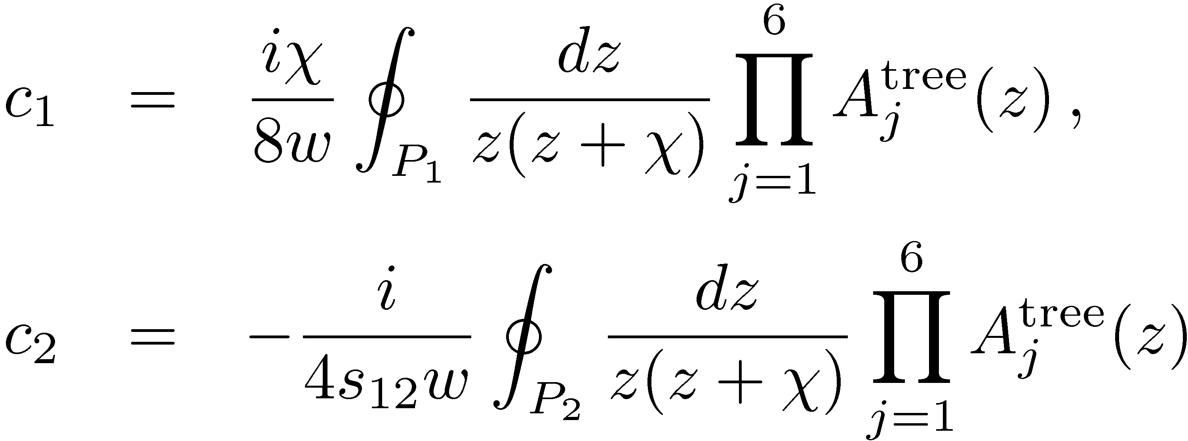
Master formulæ for basis integrals
To O (ε⁰); higher order terms require going beyond four-dimensional cuts

Slide 28
Contours

Slide 29
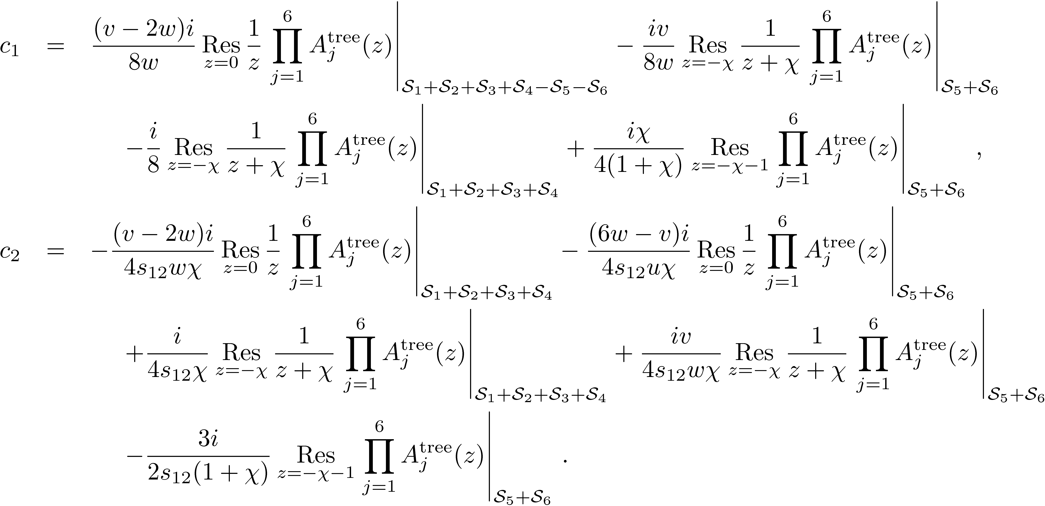
More explicit form

Slide 30
Summary
First steps towards a numerical unitarity formalism at two loops
Knowledge of an independent integral basis
Criterion for constructing explicit formulæ for coefficients of basis integrals
Four-point example

